Slide 1
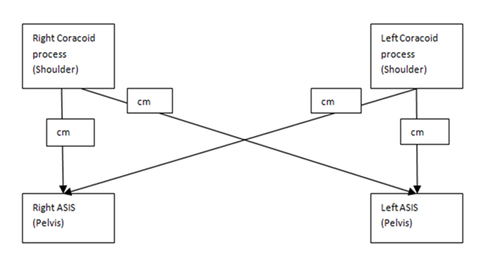
Spinal Measurements

Slide 2
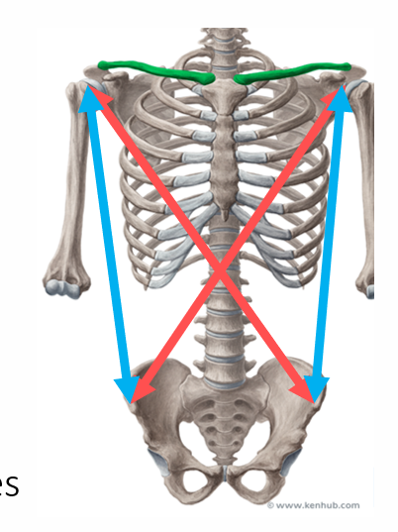
Critical Measures of the Trunk.
Provide correction in supine.
Measure with soft tape measure/ string.
Ipsilateral and contra-lateral
Helpful to monitor changes

